Slide 1

Random Forests
Gerrit Gruben, 19. January 2018

Slide 2
Decision Trees

Slide 3
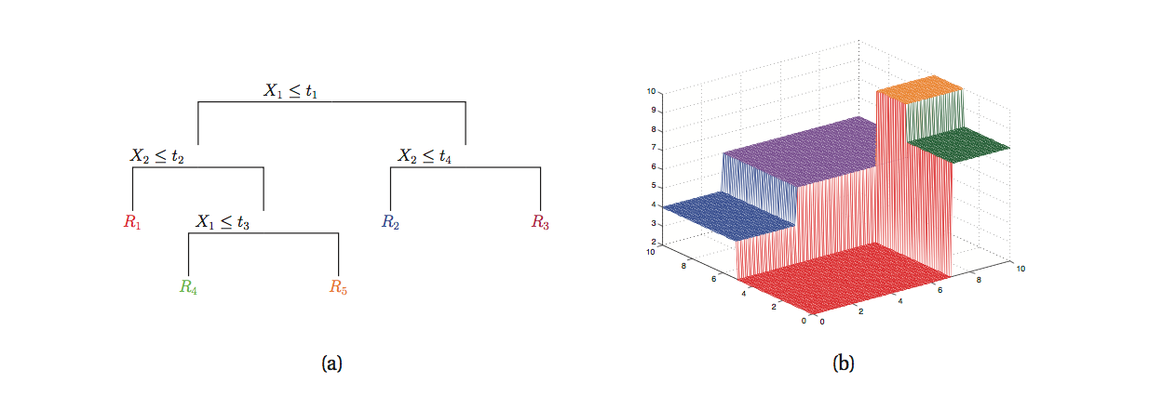

Slide 4
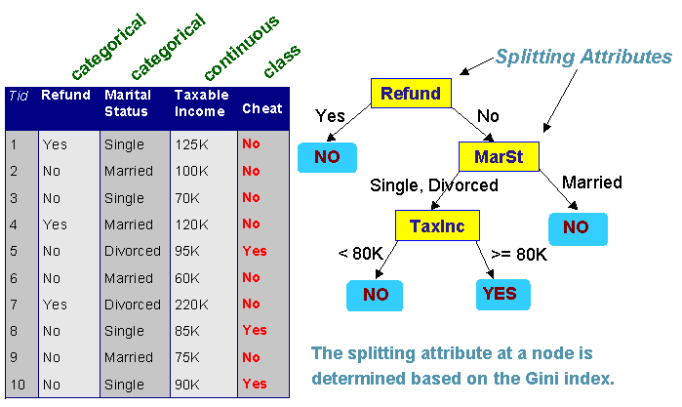
Basic Idea
Use a tree in which inner nodes split the data into two branches and terminal leafs contain a result.
Split is taken to be the one that carries “maximal” information gain.
Measured in entropy or gini.

Slide 5
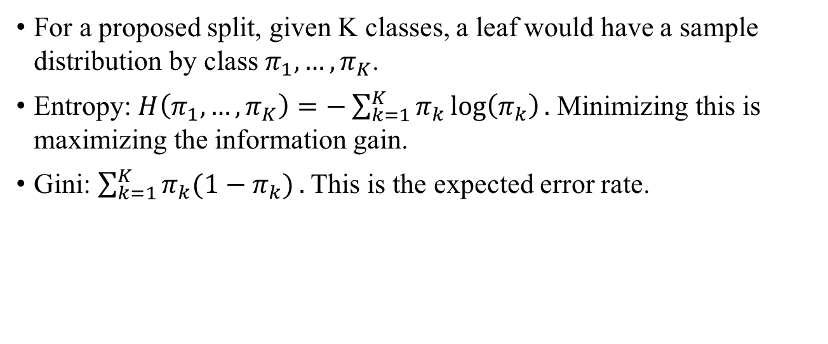
Split Criterias
For a proposed split, given K classes, a leaf would have a sample distribution by class $π_{1}, …, π_{K}$.
Entropy: $H\left(π_{1}, …, π_{K}\right)=−\sum_{k=1}^{K}{π_{k}}\log\left(π_{k}\right).$ Minimizing this is maximizing the information gain.
Gini: $\sum_{k=1}^{K}{π_{k}(1−π_{k})}.$ This is the expected error rate.

Slide 6
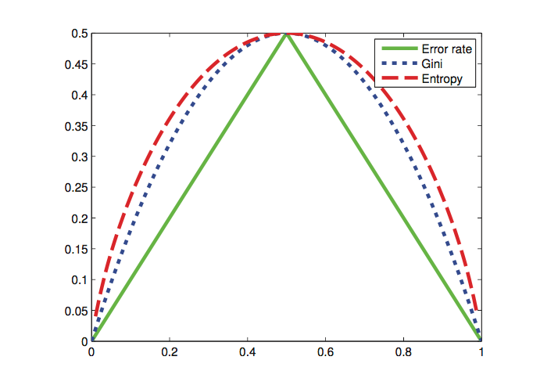

Slide 7
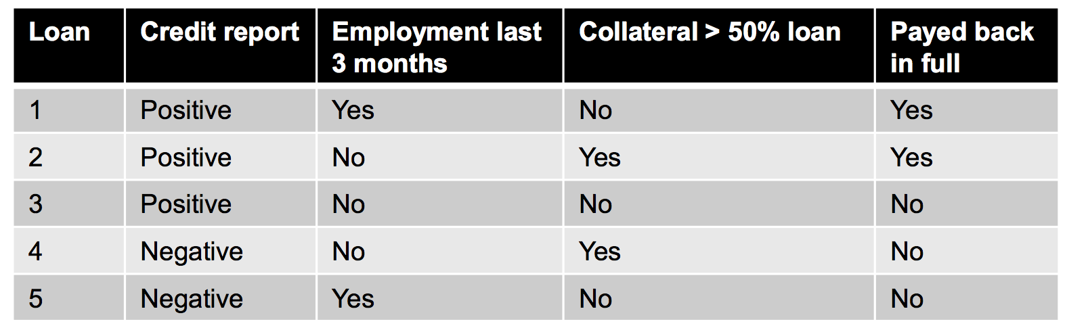
Example

Slide 8
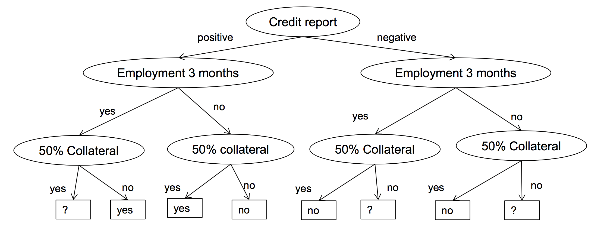
Example

Slide 9
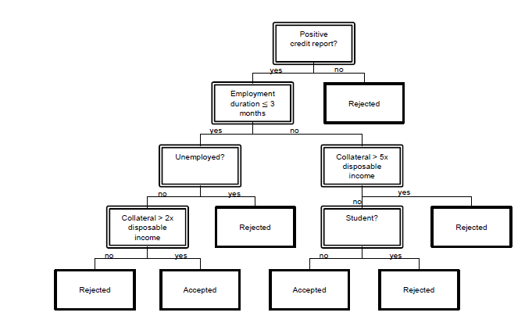
Decision Trees - Algorithms
Usually trained by CART (Breiman, 1984) or C4.5/ID3 (Quinlan, 1993/1986).
Optimal Split problem is NP-complete.

Slide 10
Decision Trees II
Every leaf has data points that supports it.
sklearn.tree.DecisionTreeClassifier
criterion: "gini" / "entropy" (kind of information)
max_features: how many features to consider at split
can be integer or ratio (float), other: "auto", "sqrt", "log2", None = all
lower values to speed up, possibly avoids overfitting (unlikely)
max_depth: limits depth of tree (deep = complex = overfitting), None → unlimited expansion.
min_samples_split / leaf: minimum support for split / at leaf.
low number could lead to overfitting.
min_impurity_split: min. impurity to split.
class_weight: weight classes for splitting, "balanced": balances imbalanced classes out (usually a good thing).

Slide 11
Decision Tree III
Decision trees are famous for overfitting.
Long lost trick: Set min_samples_leaf "high" and train models for each leaf, in other words: the decision tree pre-partitions the data set roughly, then more computation intensive / better models do the rest.
High explainability.
Got popular because of ensembling / boosting.

Slide 12
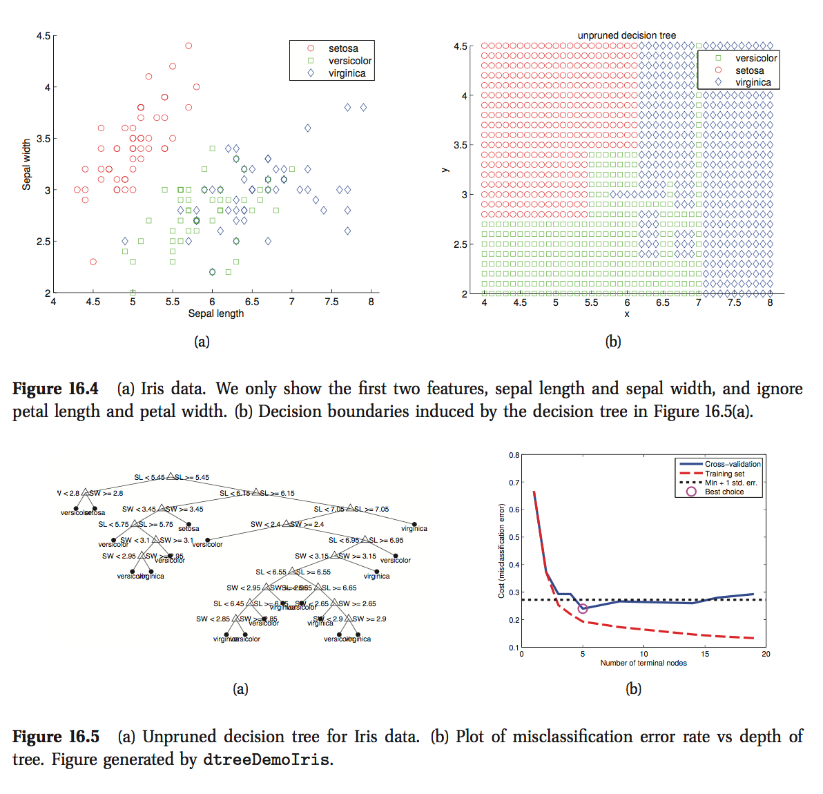
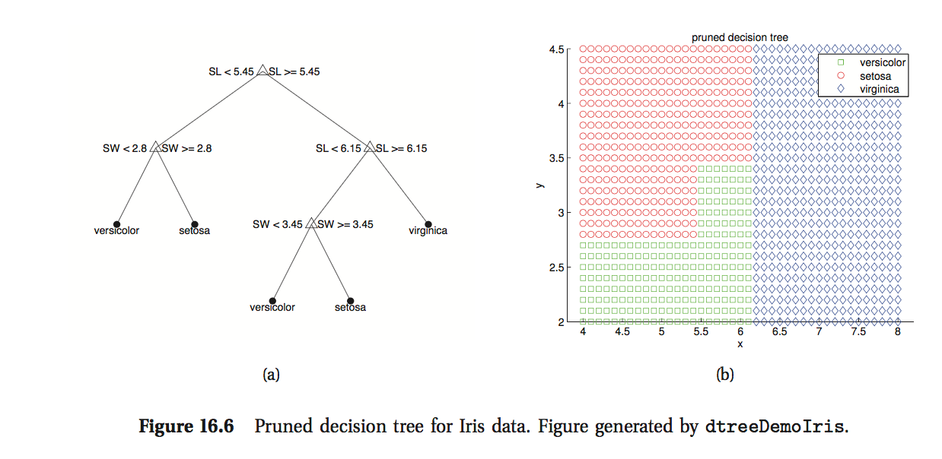
Pruning
Pruning

Slide 13
CART models
Pros
Cons
Easy to interpret
Handle mixed discrete & continuous input, robust to monotone transformations
Automatic variable selection
Robust to outliers
Scales well to large data
Overfitting deluxe (high variance estimators)
Not useful for online learning (unstable to data changes)
Often weaker compared to other models

Slide 14
Random Forests
Ensembles, Bagging, Independence…

Slide 15
Random Forests
Ensemble of decision trees.
Bagging used to fit the trees.
Random Subspace training on a feature subset.
Independence of the training process of each tree.

Slide 16
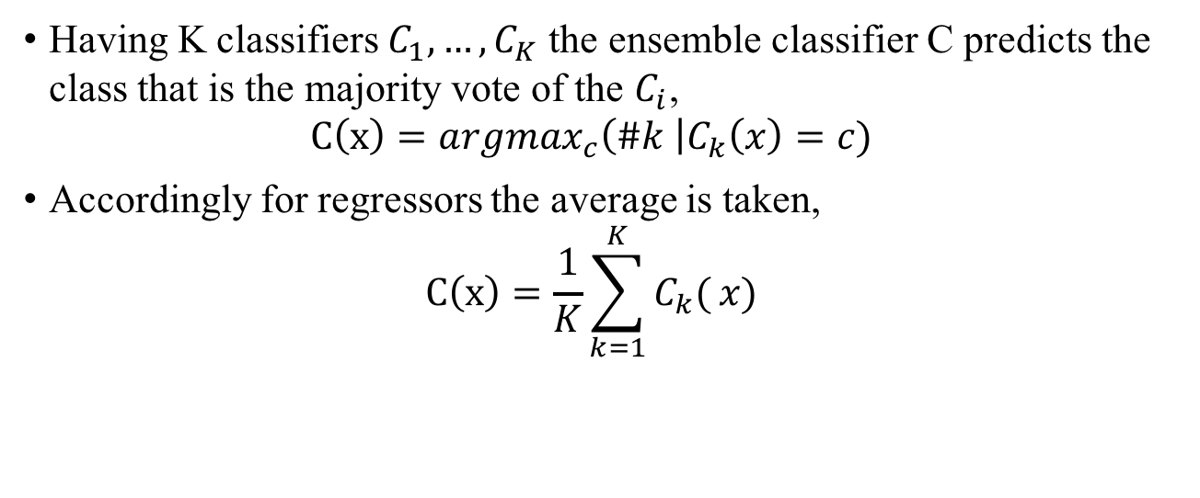
Ensemble
Having K classifiers $C_{1}, …,C_{K}$ the ensemble classifier C predicts the class that is the majority vote of the $C_{i}$, $C\left(x\right)={argmax}_{c}\left(\#k \right|C_{k}\left(x\right)=c)$
Accordingly for regressors the average is taken, $C\left(x\right)=\frac{1}{K}\sum_{k=1}^{K}{C_{k}(}x)$

Slide 17
Bagging (Bootstrap Aggregation)
The idea of bagging is to fit a model on only a subset B of the training data D, the bag.
This is combined with ensembling in RFs.
Other advantage: Can compute error metric on D – B, the out-of-bag error.
Disadvantage: Highly correlated base models.

Slide 18
Random Subset / Independence
For further decorrelation only a random subset of the features can be used, this also speeds up the training process.
In an ensemble the base models can – and should – be trained independently. => Parallelization possible.

Slide 19
Variants
ExtraTrees (in sklearn.tree and sklearn.ensemble): Only a subset of features is used at each node split.

Slide 20
Boosting

Slide 21
Boosting
Boosting: Using a weak base classifier by building a strong one by ensembling successively.
Example: AdaBoost with Decision Stumps (DTs of depth 1).
On step $m$ we have model $F_{m}$ and ideally want to have for each (x,y): $F_{m+1}\left(x\right)= F_{m}\left(x\right)+h\left(x\right)=y$ Thus we optimize $h\left(x\right)=y − F_{m}\left(x\right)$. This is Gradient Boosting.

